Slide 1
Object-Relational Mappers: mapping database tables to objects
Notes:
[Mandatory Slide] This would be the introduction slide of the topic that you are covering in this subsection.
When this slide plays, you could talk about the main aim that we’d be covering in this video.

Slide 2
In this Video, we are going to take a look at…
What is an Object-Relational Mapper?
The Django Object-Relational mapper
Notes:
[Mandatory Slide]
Before the start of the video, we’d like to highlight what are important topics or pointers that we’d be covering in this video. This slide would immediately follow the intro/name slide. This would just be say 2-3 points for the viewers to know what they are getting into.

Slide 3

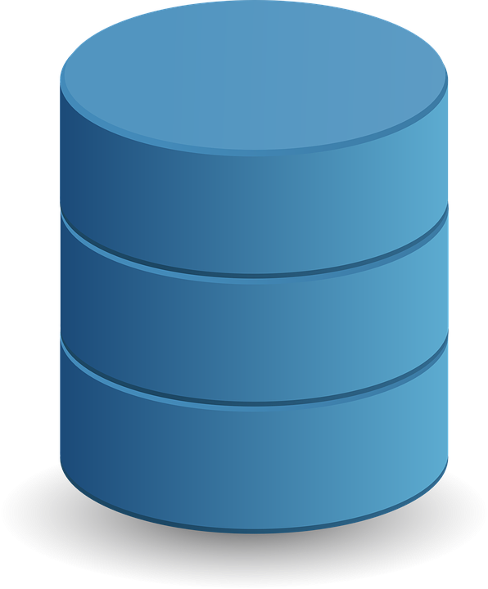

What is an Object-Relational Mapper ?
Object-Relational Mappers (ORM) are libraries providing a bridge between relational DB tables/relations and object-oriented code concepts (classes, objects). ORMs allow you to write object-oriented code instead of SQL to read/write data and schemas in your databases
ORMs usually support multiple DB backends (SQLite, PostgreSQL, Oracle, …)
ORMs:
boost productivity!
in theory allow to reuse object-oriented models across different DB techs
usually reduce data access performance (not suitable for data-intensive apps)
ORMs exist for almost all languages, noticeable ones for Python are:
The Django ORM
SQLAlchemy
Notes:
[Mandatory Slide]
Before the start of the video, we’d like to highlight what are important topics or pointers that we’d be covering in this video. This slide would immediately follow the intro/name slide. This would just be say 2-3 points for the viewers to know what they are getting into.

Slide 4
The Django Object-Relational mapper (1/2)
Django has its own ORM, which allows to pythonically query and manipulate your DBs
Schema definition
Each DB table is mapped to/by a class extending the django.db.models.Model class, and is called “model”
Models declare all their fields and relations to other models and are stored in a single file (models.py)
Once you’re done, you need to tell Django to change the state of the DB schema to the one you specified in the: this operation is called “migration”. DB migrations are saved on plain files so you can version them
models.py
from django.db import models
class Continent(models.Model):
name = models.TextField(blank=False, null=False)
class Country(models.Model):
shortname = models.TextField(blank=False, null=False)
name = models.TextField(blank=False, null=False)
continent = models.ForeignKey(Continent)
$ python manage.py makemigrations
$ python manage.py migrate
Notes:
[Mandatory Slide]
Before the start of the video, we’d like to highlight what are important topics or pointers that we’d be covering in this video. This slide would immediately follow the intro/name slide. This would just be say 2-3 points for the viewers to know what they are getting into.

Slide 5
The Django Object-Relational mapper (2/2)
Data definition
To create a new row in a table, just instantiate its model class: you can persist it on the DB by calling the save() method on it
from places.models import Continent
europe = Continent(name=’Europe’)
europe.save()
Data querying
Each model class exposes a “manager” object that can be used for queries
It has nice methods for fetching table rows via field-based filtering (also on related tables)
Any query returns a QuerySet instance, that can be iterated or further filtered → fluent interface
from places.models import Continent, Country, City
all_cities = City.objects.all()
for c in all_cities:
print(c.name)
athens = City.objects.get(name=”Athens”)
cities_starting_with_n = all_cities.filter(name___startswith=’n’)
european_cities = City.objects.filter(country__continent__name=’Europe’)
cities_oredered_by_population = City.objects.order_by(“population”)
number_of_cities = City.objects.count()
Notes:
[Mandatory Slide]
Before the start of the video, we’d like to highlight what are important topics or pointers that we’d be covering in this video. This slide would immediately follow the intro/name slide. This would just be say 2-3 points for the viewers to know what they are getting into.

Slide 6
Summary
What is an Object-Relational Mapper?
The Django Object-Relational mapper
Notes:
[Mandatory Slide]
Before the start of the video, we’d like to highlight what are important topics or pointers that we’d be covering in this video. This slide would immediately follow the intro/name slide. This would just be say 2-3 points for the viewers to know what they are getting into.

Slide 7
Exploring a simple data model through the Django ORM
Next Video
Notes:
[Mandatory Slide]
Here the name of the next video needs to be mentioned. The narration as you guessed it would be just letting the viewer know exactly where we are at and what we’d be taking over next! ☺

